Slide 1
VEHICLE INSPECTION Safety Certification
Texas Department of Public Safety
Produced by Texas Department of Public Safety Regulatory Services Division
This training is property of the Texas Department of Public Safety.
Duplication of this material is prohibited.
Notes:
For the inspection program to be effective, the vehicle inspector must be thoroughly familiar with and follow all of the provisions contained in the Vehicle Inspection Operations and Training Manual.

Slide 2
Safety certification –
five-step SEQUENCE
To ensure an inspection is performed properly and in a timely manner, the inspection should be performed in the following order:
2. Inside the Vehicle
1. Road Test
3. Outside the Vehicle
4. Underneath the Vehicle
5. Under the Hood
Notes:
Each inspection shall be a complete inspection performed by a certified inspector and shall include a check of all the items in the Vehicle Inspection Operations and Training Manual.

Slide 3
OBJECTIVES
Identify the Five-Step Vehicle Safety Inspection sequence.
Identify the required components for Safety Inspections.
Demonstrate mastery of content by scoring 80% or better on the multiple-choice examination to become a Licensed Vehicle Inspector.
Notes:
Vehicular safety is the primary intent of the Texas Vehicle Inspection Program.

Slide 4
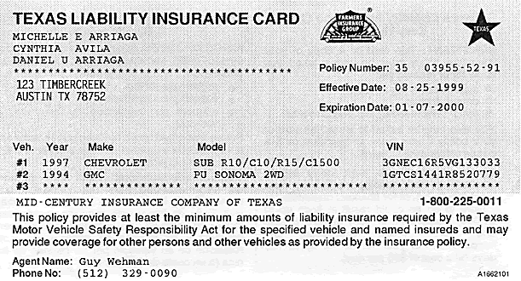
Verify financial responsibility before proceeding with any inspection.
Check for the following:
Insured’s name
Policy Number
Make of vehicle
Model of vehicle
Effective date
Expiration date
INSURED’S NAME
30 Day Minimum
The policy must meet minimum liability requirements
The policy period (dates of coverage and issued for 30 days or more)
VIN/Make & Model (should be taken from vehicle)
TX DOT Cab Card or Rail Road Commission Card are acceptable
Notes:
No proof of insurance, do not inspect vehicle.
Texas minimum requirements: $30,000/$60,000/$25,000 per occurrence.
Vehicles EXEMPT from this requirement: Government vehicles (US, State – Texas, County, City), vehicles registered to Volunteer Fire Departments, and vehicles registered with “Antique” license plate.
Vehicles not registered in the state of Texas may be inspected, and issued a Vehicle Inspection Report if they meet Texas’ requirements, including evidence of Financial Responsibility.

Slide 5
Vehicle Identification Number, Motor, or Serial Number
Make a physical check of the motor block, frame, or body part for the Vehicle Identification Number (VIN), motor, or serial number.
Station or certified inspector suspension can result from taking this number from the old Vehicle Inspection Report, title, or registration receipt.
The entire vehicle identification number must be used.
Vehicles with altered or removed vehicle identification numbers/ motor/ serial numbers should be reported to your Department representative.
Notes:
Refer the motorist to contact DMV if the vehicle has no VIN.

Slide 6
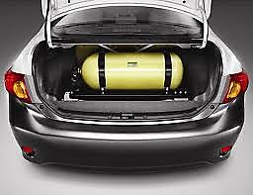
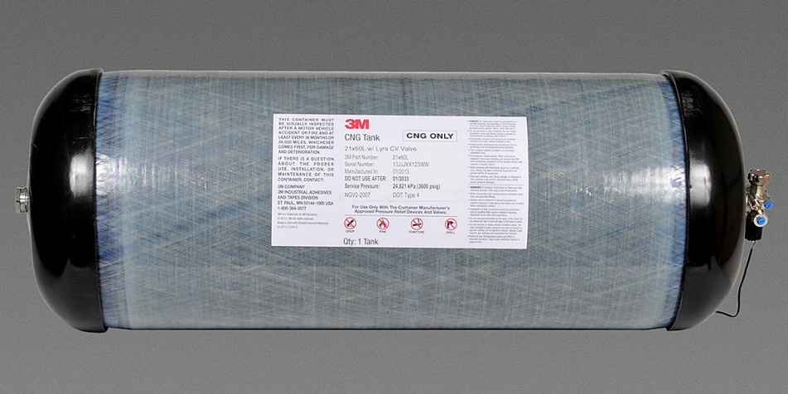
CNG (Compressed Natural Gas)
After verifying vehicle insurance, the CNG tank should be inspected (customer only needs to be present if the tank is located in the trunk).
A CNG-equipped vehicle:
Must comply with the requirements of 49 CFR 571.304
The fuel container tank has not exceeded the expiration date
The inspector can complete this inspection requirement through observation and/or documentation.
Notes:
As a pre-requisite to inspecting a CNG equipped vehicle, the inspector must verify that a motor vehicle equipped with a CNG Fuel System complies with the requirements of 49 CFR 571.304 and that the expiration date of the fuel container tank has not been exceeded. The inspector can complete this inspection requirement through observation and/or documentation.
After verifying vehicle insurance, the CNG tank should be inspected with the vehicle owner present. The customer only needs to be present if the tank is located in the trunk.

Slide 7
1
ROAD TEST
Service Brake
Parking Brake
Steering
Notes:
The brake test area and location must be marked and maintained by the inspection station.
The area and location must be approved by the Department representative supervising the station. Any change in the location or additions to the brake test area must be approved by the supervising Department representative.

Slide 8
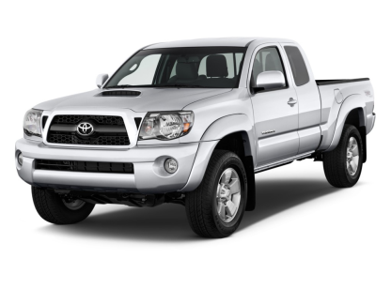
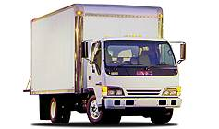
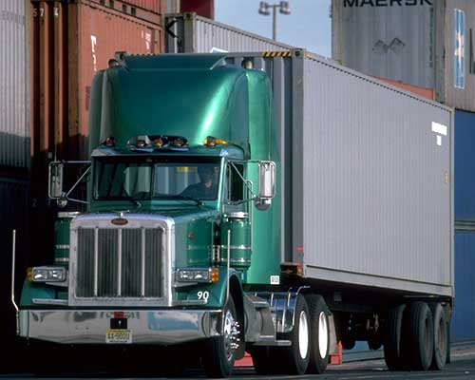
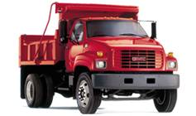
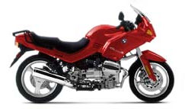
SERVICE BRAKE
At a speed of 20 mph, apply service brakes firmly to determine if the vehicle comes to a smooth stop within the distance prescribed by the "Required Brake Performance.” The test should be performed at a designated and approved brake test area.
Required Vehicle Brake Performance
Required Vehicle Brake Performance
25 Ft
30 Ft
40 Ft
50 Ft
Check equalization and any metal-to-metal sounds during the test
Notes:
Brake test area must be used on every inspection made.

Slide 9
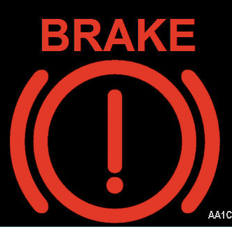
SERVICE BRAKE
REJECT IF:
Red brake warning lamp or signal is on or comes on during the test.
Brakes do not meet requirements for stopping distances for the class of vehicle.
Remember:
An Anti-lock (ABS) lamp or signal that is on or comes on during test will not cause for rejection.
Notes:
Using the service (foot) brake only, the stopping ability of the vehicle should be tested by actual operation of the vehicle. When applying brakes to the moving vehicle, the braking force must be evenly distributed to the wheels. The driver should have a firm control of the steering wheel throughout the test.

Slide 10
2
INSIDE THE VEHICLE An Inspector should inspect the following items
Windshield Wiper Control (On/Off Switch)
Horn
Turn Signal
Indicator
Mirror
Seat Belts
Brake Pedal Reserve
Parking Brake
Steering
High Beam Indicator Lamp (1948 & up)
Notes:
All inspections must be made only in the approved inspection areas at the location approved by the Texas Department of Public Safety.

Slide 11
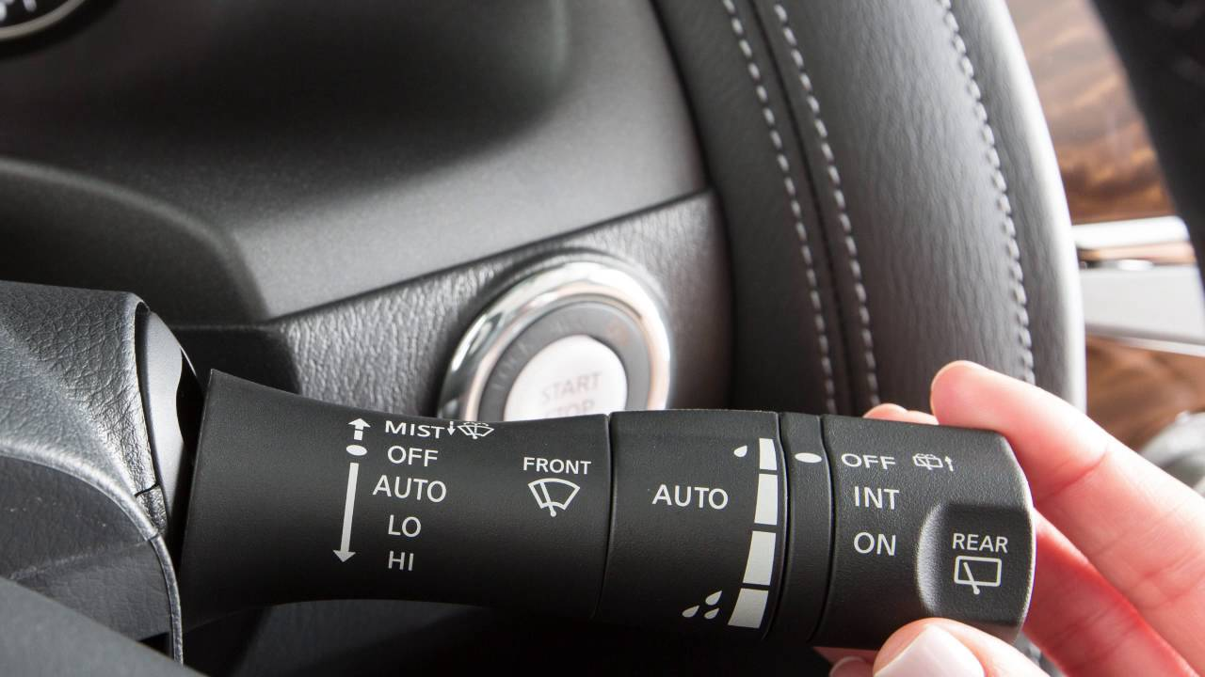
WINDSHIELD WIPER CONTROL
Every motor vehicle with a windshield must be equipped with a windshield wiper or wipers in good working order and constructed to permit operation and control by the vehicle’s driver.
Notes:
All motor vehicles which were originally equipped (manufactured) with one wiper, only one wiper is required; if originally equipped (manufactured) with two or more wipers, all wipers will be required.

Slide 12
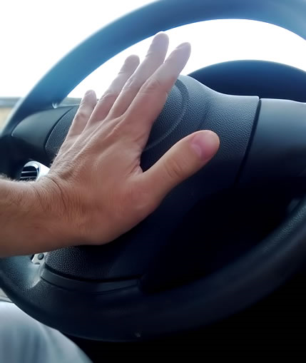
HORN
Every motor vehicle shall be equipped with a horn (electric or air) in good working order and capable of emitting a sound audible for a distance of 200 feet or more. It cannot emit an unreasonably loud, harsh sound or a whistle.
Notes:
Horn switch must be readily accessible to vehicle operator.

Slide 13
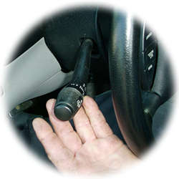
TURN SIGNAL INDICATOR
Switch / Lock / Indicator Lamps assembled before the model year 1960 need not be equipped with electric turn signal lamps.
Remember: The selector switch must lock in the proper turn position when applied but need not cancel automatically.
Notes:
Check operation and condition visually.

Slide 14
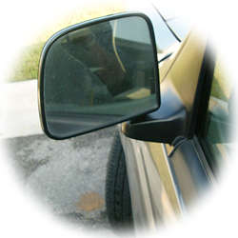
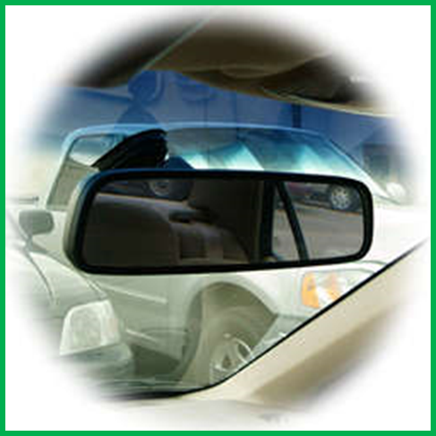
MIRROR
Every motor vehicle shall be equipped with a mirror so located as to reflect to the driver a view of the highway for a distance of at least 200 feet to the rear.
Only ONE mirror is required
Exterior Mirror
Interior Mirror
Mirrors should not be cracked, peeled, tarnished, or improperly/loosely mounted.
Notes:
Inspect only one mirror. If the vehicle is equipped with more than one mirror, only one, either inside or outside, needs to meet all requirements.

Slide 15
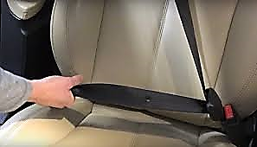
SEAT BELTS
Front seat belts are required on every motor vehicle in which front seat belt anchorages are part of the manufacturer’s original equipment.
Inspect front lap seat belts only
Notes:
Anchorages defined: A seat belt anchorage consists of a threaded hole in suitable structure to receive the seat belt attachment fittings or a circular anchor which is welded to the vehicle chassis. Self-threading bolts are inserted into the anchor to form the complete seat belt anchorage assembly.

Slide 16
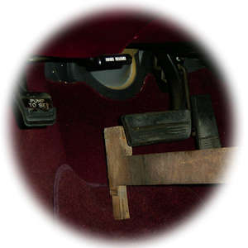
BRAKE PEDAL RESERVE
Power Brakes (1”)
Conventional Brakes – Non-power (2”)
Brake Pedal Reserve: Distance from the back of the brake pedal (when engaged) to the floorboard
Notes:
The purpose of the pedal reserve check is to ascertain the degree of the brake adjustment and to demonstrate satisfactory brake actuating system condition.

Slide 17
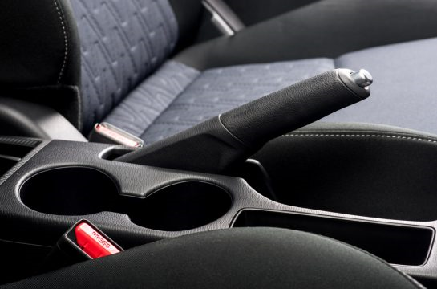
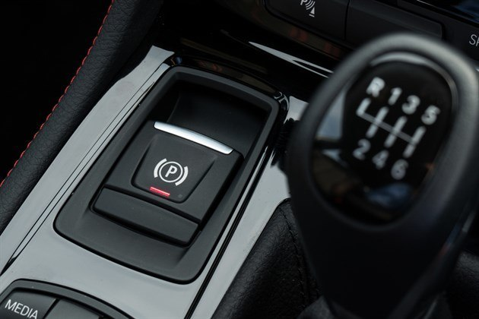
PARKING BRAKE
The parking brake should be designed so that it shall remain applied - despite exhaustion of any energy source or leakage of any kind. Inspect all 1960 and newer vehicles.
Motor vehicle is not equipped with a parking brake
Operating mechanism, when fully applied, does not hold the vehicle.
Notes:
On a motor vehicle that has the automatic parking brake release when the transmission is placed in gear, the parking brake should be applied, and the engine accelerated enough to cause a slight pull on the braking mechanism to determine if it is working properly.

Slide 18
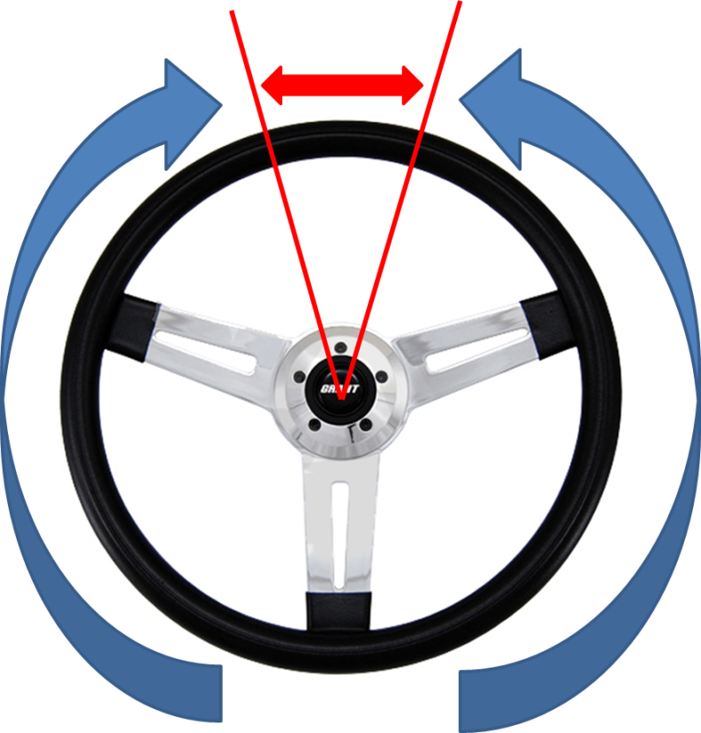
STEERING LASH
The vehicle’s steering system must be inspected to determine if excessive wear and/or maladjustment of the steering linkage and/or steering gear exists.
Inspection Procedure:
Check lash & free movement: turn the steering wheel from full left to full right
Check wheel size/column
Tilt steering wheels must lock into position.
The steering wheel must be securely mounted to the steering shaft.
Notes:
Lash or Free Play: With steering axle tires in straight ahead position, turn steering wheel until the turning motion can be observed at the steering axle tires. Measure lash (See VI-87 4.20.28 Steering Lash Chart).
On vehicles equipped with power steering, the fluid level, belt tension and belt condition must be checked for compliance before starting the engine to check for proper operation of the steering. On vehicles equipped with power steering, the engine must be running when measuring steering lash.

Slide 19
HIGH BEAM INDICATOR
All motor vehicles registered in this state after January 1, 1948, other than a motorcycle or motor-driven cycle, which has multiple beam road lighting equipment, shall be equipped with a beam indicator which shall be lighted whenever the uppermost distribution of light from the headlamp is in use and shall not be otherwise lighted. It can be any color.
Not equipped
Improper switching indication
Produces a glaring light
Inoperative for any reason
Notes:
Indicator shall be so designed and located that when lighted it will be readily visible without glare to the driver of the vehicle.

Slide 20
3
OUTSIDE THE VEHICLE An Inspector should inspect the following items
Tires
Safety Guards or Flaps
Wheel Assembly
Wheels
Windshield Wipers
Lighting Equipment
Window Tint
Gas Cap

Slide 21
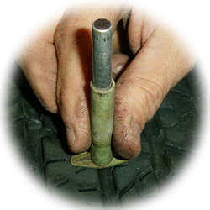
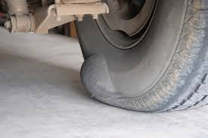
TIRES
All tires on a vehicle will have a proper tread depth of at least 2/32 of an inch and be in safe operating condition.
Inspection Procedure:
Tread depth & condition (no cord exposed or sidewall separation; no visible bumps, bulges, or knots)
Cuts, snags, & tears not more than one inch
Tread wear indicators should not contact the road on any two adjacent major grooves in the center or the middle of the tire
Notes:
No tire shall be passed to be in safe operating condition unless it meets the visual and tread depth requirements.

Slide 22
SAFETY GUARDS OR FLAPS
Required on Trucks/Light Trucks behind the rearmost axle or (combination) if it has 4 or more tires (always required on dual wheel pickups)
Inspection Procedure:
Height/Width required (as wide as the tires they are protecting; no more than 12” above the roadway)
Exceptions: Truck tractors, motor homes, buses, pole trailers
Notes:
Safety guards or flaps shall be at least as wide as the tires they are protecting.

Slide 23
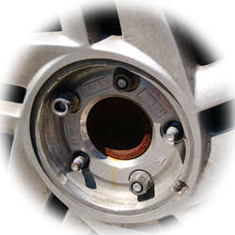
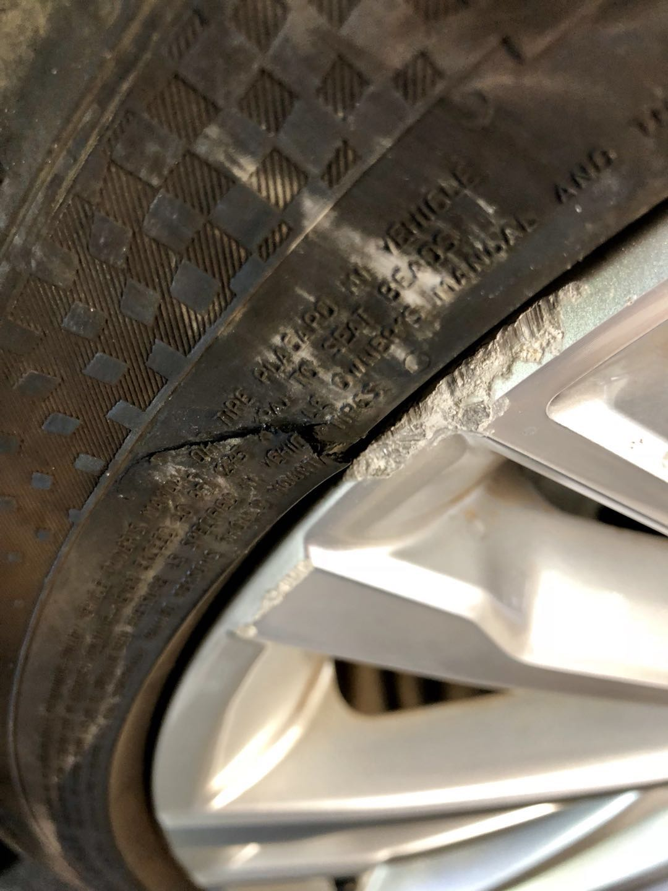
WHEEL ASSEMBLY
The inspection of all wheels and rims will be visual.
REJECT IF:
Loose, missing, or damaged wheel studs, bolts, nuts, or lugs.
Any part of the wheel is bent, cracked, re-welded, or damaged to affect the safe operation of the vehicle.
Notes:
Inspection procedure: Examine visually.

Slide 24
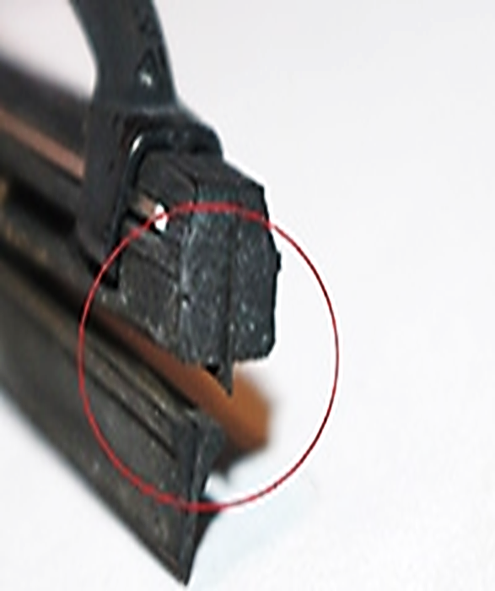
WINDSHIELD WIPERS
REJECT IF:
The rubber element that contacts the windshield is torn more than 1” on one end or a combination of 1” on both ends.
Number required (as many as originally equipped).
Wiper blades are not making proper contact with the windshield.
Notes:
Inspect for proper contact of blades with windshield. Raise arm away from windshield and release. Arm should return to original position and wiper blade should contact the windshield firmly.

Slide 25
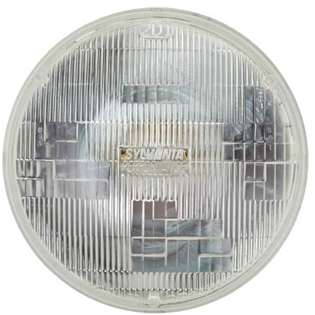
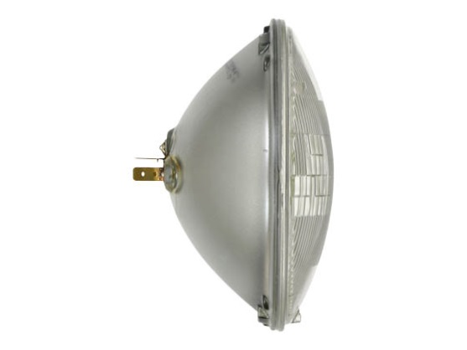
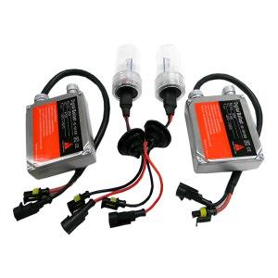
HEADLAMPS
Sealed Beam
Composite
High-Intensity Discharge (HID)
Projection
Notes:
Composite vs. Sealed Beam Headlights. For composite beam headlights, the individual bulbs can be removed and replaced as needed. By contrast, for sealed beam headlights, the entire unit needs to be replaced when a bulb burns out.

Slide 26
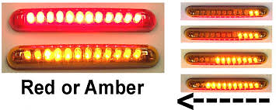
LAMPS
Motor vehicles shall be equipped with the following:
Headlamps (2; clear/white) glass or composite lens with condensation will not fail; a sealed beam lamp will fail for having condensation; height requirement: 24” – 54”
Stop lamps (1959/older, 1 stop lamp; 1960/newer, 2; red or amber or any shade of color between red and amber)
Tail lamps (1959/older, 1 tail lamp; 1960/newer, 2; red); height requirement: 15” – 72”
Composite
LED LIGHTS
NOTE: 50% of diodes must be functioning for LED Stop or Tail lamps to pass inspection.

Slide 27
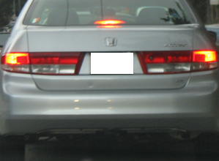
LAMPS
Wiring should not be shoddy
Lamps lenses should not be broken
All lamps should be securely mounted, not loose
No painted/colored/tinted lenses
Notes:
Any lamp lens on a vehicle that is painted, smoked, or tinted will be rejected due to the lens no longer meeting the visibility requirements (FMVSS 49 CFR Part 571.108, Lamps & Reflective Devices).

Slide 28
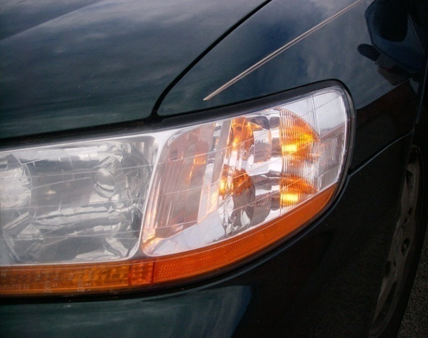
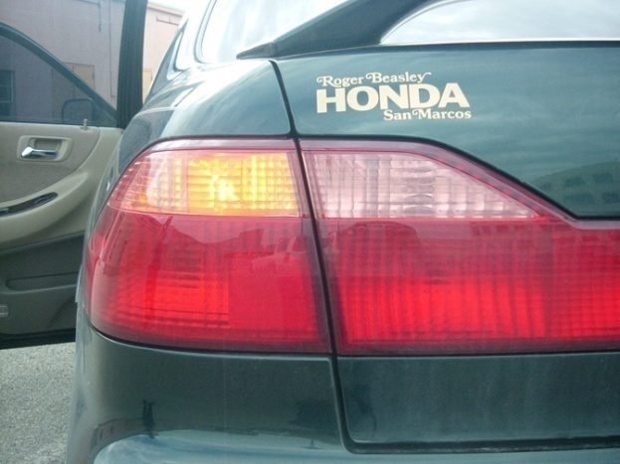
TURN SIGNAL LAMPS
Turn signal lamps: required on all vehicles beginning 1960 or newer (2 in front, white or amber; 2 in the rear, red or amber)
White or AMBER to the Front
Red or AMBER to the Rear

Slide 29
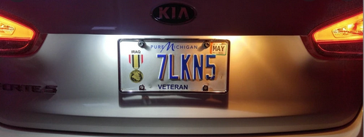
LICENSE PLATE LAMP
The license plate lamp shall illuminate with a white light the rear registration plate and render it clearly legible for a distance of 50 feet to the rear.
Any such lamp shall be so wired as to be lighted when the headlamps or auxiliary driving lamps are lighted.
One license plate lamp is required; clear or white
Check for mounting and lens condition

Slide 30
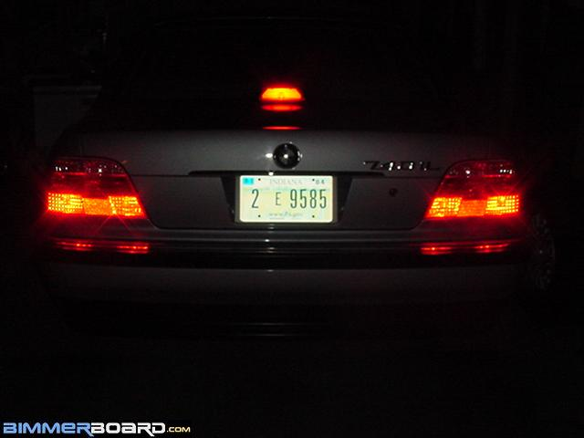
CENTER HIGH-MOUNTED STOP LAMPS
Center high-mount stop lamp (red; steady-burning when stop lamps are applied) are required on:
Passenger cars produced after September 1, 1985, and newer (1986 Model vehicles).
Multipurpose passenger vehicles, trucks, and buses less than 80 inches in width and gross weight of 10,000 lbs. or less on or after September 1, 1993 (1994 Model vehicles).
Notes:
Any truck that has a camper shell that covers the red center high mounted stop lamp shall not be rejected. However, if the camper shell was manufactured with a red center, high mounted stop lamp it must be operable at the time of inspection. The red center, high mounted stop lamp, if required, will not be a substitute for any other required stop lamp.

Slide 31
CENTER HIGH-MOUNTED STOP LAMPS
A new type of 3rd brake lamp has been approved in use of passenger vehicles, light trucks and SUVs less than 80” wide. This 3rd brake lamp, which uses light emitting diodes (LEDs), flashes or pulses briefly and remains lighted when the vehicle’s brake pedal is pressed.
Notes:
For a short video about this new type of 3rd brake lamp, can be viewed at: https://www.youtube.com/watch?v=9C3Z8EwThNg

Slide 32
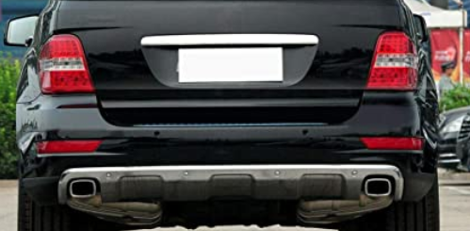
REAR REFLECTORS
2 required - RED in color; height requirement:15”- 60” from the center of the reflector to the level ground

Slide 33
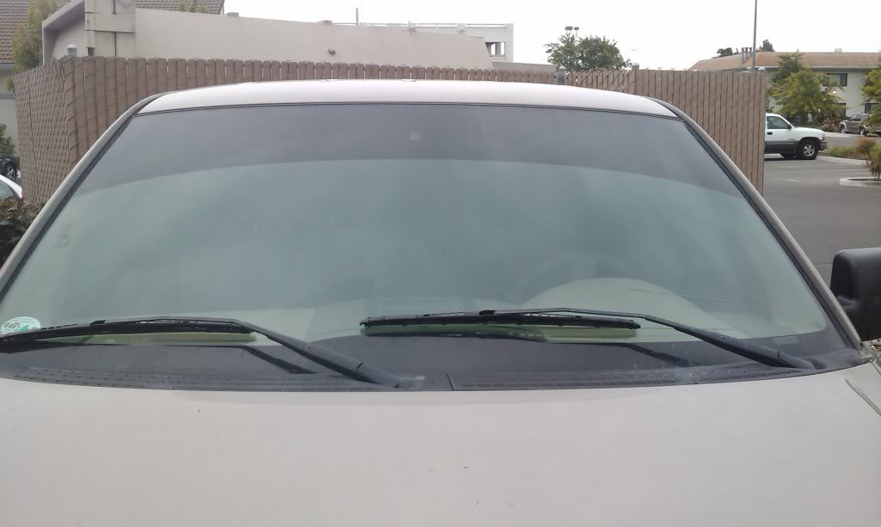
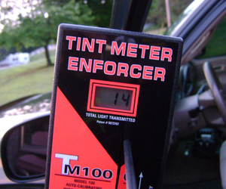
WINDOW TINTING
All vehicles that have applied window coating, tinting, or sun screening on the windows must be inspected.
Minimum percentage 25% light transmittance – below 25% fails
Inspect FRONT driver/passenger’ windows only
Windshield brow cannot extend downward beyond the AS-1 line or more than five (5) inches from the top of the windshield on vehicles without an AS-1 line. Measurement shall be taken from inside the windshield.
No RED, BLUE, AMBER, or reflective type
Notes:
Vehicles with windows which cannot be raised or lowered for the inspection of window tint will require that the inspection be terminated.

Slide 34
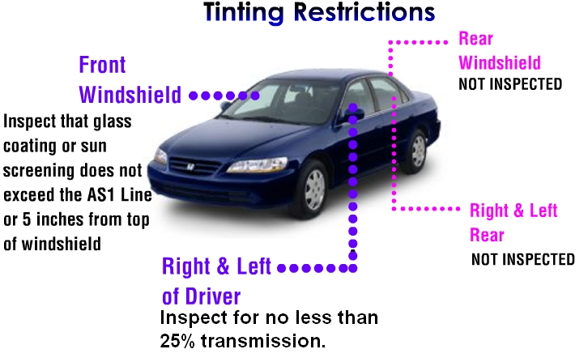
WINDOW TINT
Rear
Window

Slide 35
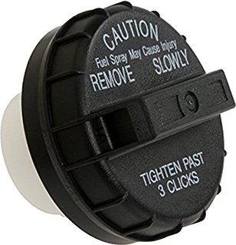
FUEL CAP
Every gasoline-powered vehicle from 2-24 model years old will be checked for the presence of and tested with a Department approved “Gas Cap Testing Device” to determine if the gas cap is defective.
Exempted Vehicles:
Slow-moving vehicles
Motorcycles
Vehicles operated exclusively by a fuel other than gasoline
Vehicles newer than 2 years old and older than 24 years old
Vehicles manufactured with a cap-less fuel system.

Slide 36
4
UNDER THE VEHICLE An Inspector should inspect the following items
Service
Brake
Parking Brake
Exhaust System

Slide 37
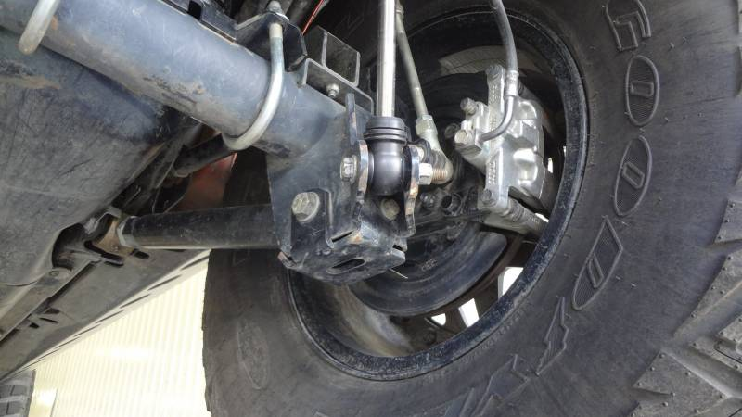
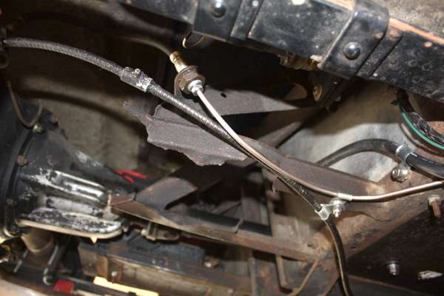
SERVICE BRAKE
Check brake lines/hose for leaks and condition

Slide 38
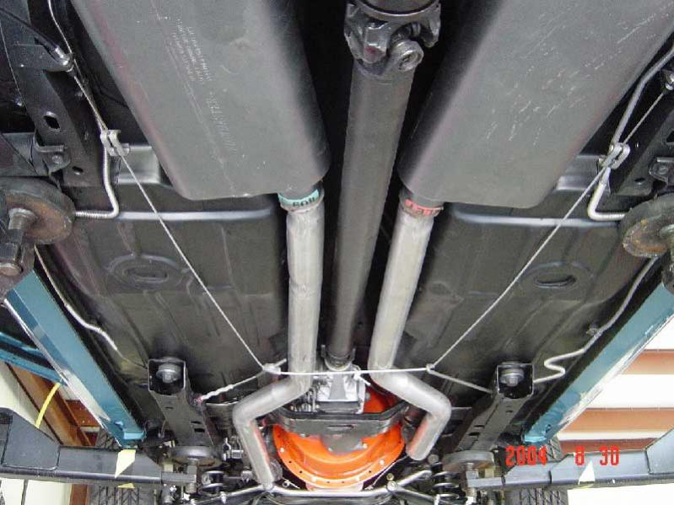
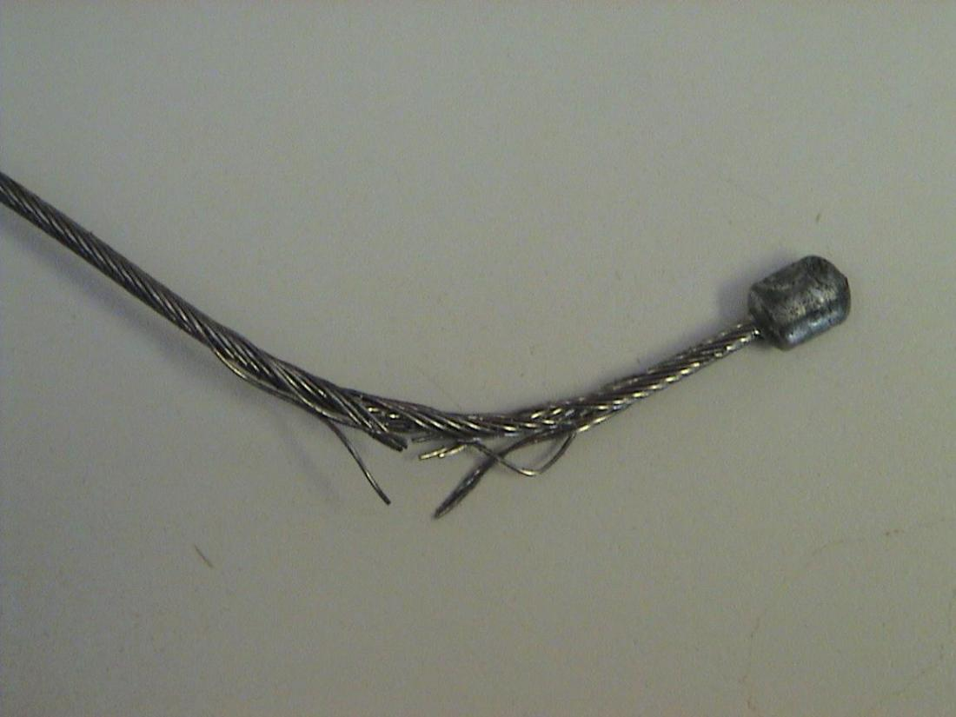
PARKING BRAKE
Inspected for vehicles 1960 and newer
REJECT IF:
Missing parts, broken, badly worn, or not operating properly.
Pull cables that are badly stretched, frayed, or not working properly.

Slide 39
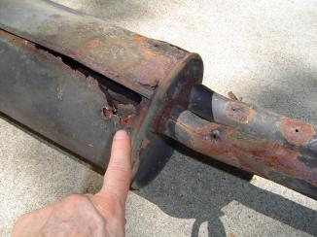
EXHAUST SYSTEM
Every motor vehicle shall be equipped with a muffler in good working order and in constant operation. The exhaust system includes the exhaust manifolds, gaskets, exhaust pipes, catalytic converters, mufflers, resonators, tailpipes, hangers, and supporting hardware.
The exhaust system shall be examined visually while the engine is running to determine the system’s efficiency.
Catalytic converter (required on ‘84 & up)
Notes:
Some diesel engines were equipped from the manufacturer with catalytic converters. The catalytic converters on diesel-powered motor vehicles will be inspected for presence and leaks only.

Slide 40
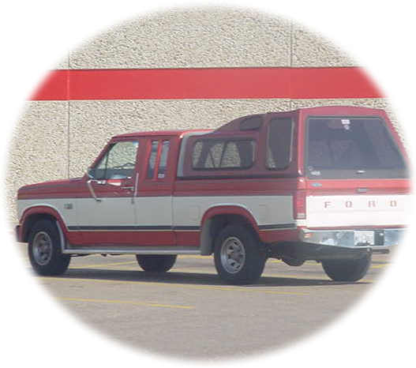
EXHAUST SYSTEM
The tailpipe should discharge the exhaust at the rear, sides, or top of the vehicle’s passenger compartment.
Reject if:
Vehicle is not equipped with a muffler.
Pickups equipped with a camper or hard shell cover that does not discharge the exhaust at the rear or sides.
Leaks, holes & patches
Exceptions: Holes in the exhaust system made by the manufacturer for drainage are not cause for rejection.
Notes:
Some pickups are equipped with a camper or hard shell cover and are sometimes used for the transportation of passengers. The tailpipe should discharge the exhaust at the rear or sides. This truck modification will be considered as a passenger compartment.

Slide 41
5
UNDER THE HOOD An Inspector should inspect the following items
Exhaust Emissions System
Master Cylinder
Power Steering
Exhaust Manifold

Slide 42
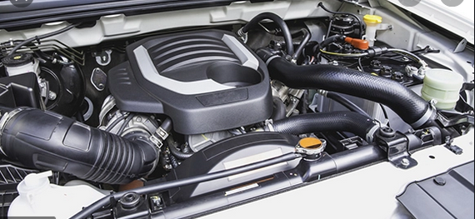
EXHAUST EMISSIONS SYSTEM
Year model (1968 and newer)
Inspect air injection system, thermostatic air cleaner, evaporative emission system, exhaust gas recirculation system, positive crankcase ventilation system, catalytic converter
The system cannot be removed, disconnected, or altered in any manner to make it ineffective
Plumbing or hoses cannot be loose, broken, leaking, or improperly routed
Air pump belt cannot be loose, removed, excessively cracked, frayed, or have pieces missing.
Catalytic converter cannot be removed, leaking, or disconnected on a 1984 or later model vehicle.
Notes:
Some diesel engines were equipped from the manufacturer with catalytic converters. The catalytic converters on diesel-powered motor vehicles will be inspected for presence and leaks only.

Slide 43
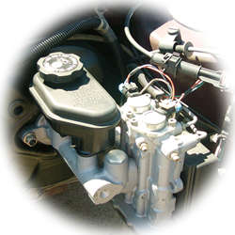
MASTER CYLINDER
Inspect for any leaks
Fluid level in the master cylinder is more than 1 inch below the top of the reservoir or below the manufacturer’s recommended level
Reject if:

Slide 44
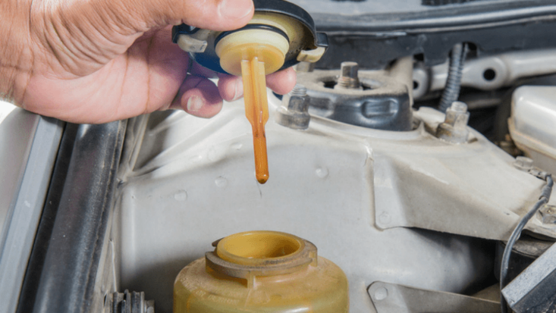
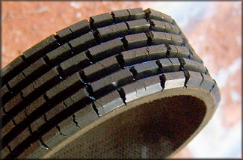
POWER STEERING
Inspect the belt for condition. Serpentine belts are not to be rejected merely for cracks in the ribs.
Check for leaks in the power steering unit or hoses.
Fluid level in the power steering unit will fail if below the manufacturer’s recommended level.
Steering mechanism is not firmly attached and free of frame cracks or missing bolts.
REJECT IF:

Slide 45
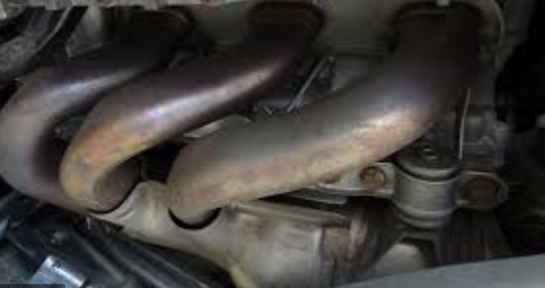
EXHAUST MANIFOLD
The exhaust system shall be examined visually while the engine is running to determine the system's efficiency.
Inspect Condition
Manifold is cracked or broken, causing leakage.
Reject if:

Slide 46
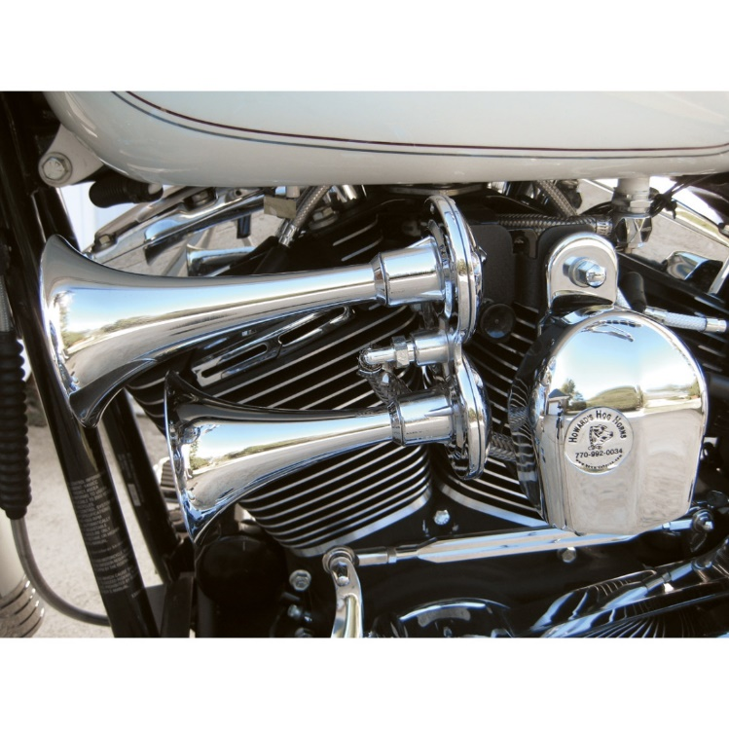
MOTORCYCLE AND MOTOR-DRIVEN CYCLE
Proof of Insurance
Horn
Mirror; 1 required
Steering
Brakes (system); equipped on all wheels; sidecars not required to have brakes

Slide 47
MOTORCYCLE AND MOTOR-DRIVEN CYCLE
Inspect
Tires
Wheel Assembly (Spokes cannot be bent, broken, loose, or missing)
Exhaust System (must have a baffle)
Tail Lamp (1); RED in color; height requirement: 20” – 72”

Slide 48
MOTORCYCLE AND MOTOR-DRIVEN CYCLE
Stop Lamp (1): RED or AMBER or any shade of color between red and amber in color.
License Plate Lamp; (1); white or clear in color
Rear Red Reflector (1); height requirement: 15”-60”
Headlamp (1); white/clear in color; height requirement: 24”-54”

Slide 49
MOPEDS
An Inspector should inspect the following items
Check Financial Responsibility
Brake (rear wheel)
Headlamp (1); white/clear
Reflector (1); RED
Tail Lamp (1); RED

Slide 50
TRAILERS, SEMI-TRAILERS, POLE TRAILERS, OR MOBILE HOMES
Inspection is required when gross weight or registered weight exceeds 7500 lbs.
Insurance taken from towing vehicle
Must have a VIN
Notes:
Refer the motorist to contact DMV if there is no VIN.

Slide 51
TRAILERS, SEMI-TRAILERS, POLE TRAILERS, OR MOBILE HOMES
Turn signal lamps must emit a RED or AMBER light.
2 Tail lamps; RED
2 Stop lamps; RED or AMBER or any shade of color between red and amber in color.
2 Rear Reflectors; RED
License Plate Lamp (1; white/clear)
Notes:
A stop lamp on a Commercial Motor Vehicle (CMV) must emit a RED light and be visible from a distance of not less than 300 feet to the rear in normal sunlight.

Slide 52
TRAILERS, SEMI-TRAILERS, POLE TRAILERS, OR MOBILE HOMES
Tires (2/32nd)
Safety Guards or Flaps (if required)
Wheel Assembly
Brake System
Vehicles and Trailers 80” or wider must have clearance, side marker lamps, and reflectors.
20 mph
40 Ft
50 Ft
Notes:
Towing vehicle under 10,000lbs. GVW with trailer = 40 ft.
Towing vehicle over 10,000lbs. = 50 ft.

Slide 53
Vehicle Inspection Criteria Buses & School Buses

Slide 54
SCHOOL BUSES
Inspect these additional items
Seat Belts (driver only)
Clearance Lamps
Side Marker Lamps
Side Reflectors
Gas caps on vehicles 2-24 model years old
Notes:
All items, not specifically mentioned, should be inspected according to the procedures discussed in the “Safety” portion of the training curriculum.

Slide 55
SCHOOL BUSES
RED Warning Lamps (2 front – 2 rear – alternately flashing); visible at 500 feet in normal sunlight.
Buses equipped with 8 warning signal lamps; 4 RED and 4 AMBER; working in an automatic integrated system, is acceptable provided it has 2 RED lamps on the front and 2 RED lamps on the rear.
Signs (“SCHOOL BUS” not less than 8 inches in height on the front and rear of the bus)

Slide 56
SCHOOL BUSES
Fire Extinguisher (1 quart chemical & conveniently located for immediate use)
Exterior Crossover (Convex) Mirror

Slide 57
Rejected Vehicles
All vehicle inspections performed, passed, failed, or rejected shall be entered into the system.
The owner or operator of a vehicle that’s been rejected must make or have made the necessary repairs or adjustments and return to the original inspection station for one reinspection within fifteen (15) days from the date of rejection (excluding the day of rejection) to obtain the one reinspection without charge.
Inspector shall always obtain authorization from the vehicle owner/operator before making any repairs or adjustments.
Vehicle owners/operators may have repairs or adjustments completed by any qualified person of their choice.
Notes:
If an inspector makes a mistake on a Vehicle Inspection Report (VIR), the vehicle shall be inspected again and a new Vehicle Inspection Report issued at no charge.

Slide 59
Emissions Affidavit
Emissions Testing Exemptions
A vehicle registered in an emissions county that is gasoline-powered and two (2) to 24 years old must be emissions tested or qualify for the VIE-12 Affidavit. The current administrative rules prohibit stations, not certified to do emissions testing, from inspecting these vehicles unless the applicant can demonstrate they meet one of the following exemptions.

Slide 60
Emissions Affidavit
The vehicle being presented for inspection is EXEMPT from having to have an emissions inspection because:
1. Vehicle is not subject to the Texas Vehicle Emissions Inspection and Maintenance Program because said vehicle is not and will not be primarily operated (driven, parked, or stored for 60 calendar days per testing cycle) in affected counties. I further certify that in the future if said vehicle is primarily operated in affected counties, said vehicle will be reinspected at an inspection station certified to do emissions testing. (Registered in an affected county, but operated outside an affected county; e.g., company fleet vehicle, hunting vehicle, exempt from emission test on resale, etc.)

Slide 61
Emissions Affidavit
2. Vehicle is no longer subject to the Texas Vehicle Emissions Inspection and Maintenance Program because said vehicle is no longer and will no longer be primarily operated {driven, parked, or stored for 60 calendar days per testing cycle) in affected counties. I further certify that in the future if said vehicle is primarily operated in affected counties, said vehicle will be reinspected at an inspection station certified to do emissions testing. (Registered in an affected county. but owner does not currently reside in an affected county and will not operate over 60 days per calendar year in an affected county, e.g., someone who moved from an affected county.)

Slide 62
Emissions Affidavit
3. Will not return to an affected county prior to the expiration of the current inspection certificate. I further certify that immediately upon return to an affected county, said vehicle will be reinspected at an inspection station certified to do emissions testing. (Registered in an affected county and primarily operated in an affected county, but outside county upon expiration of inspection certificate; e.g., student, vacationer, extended out-of-town business.

Slide 63
Notes:
The department will administer penalties by the category of the violation. The violations listed in this section are not an exclusive list of violations. The department may assess penalties for any violations of Texas Transportation Code, Chapter 548 (the Act), or rules adopted by the department. The attached graphic summarizes the violation categories and illustrates the method by which penalties are enhanced for multiple violations.

Slide 64
If a certified inspector changes their place of employment, the Department representative must be notified immediately.
If a certified vehicle inspector changes their name or place of residence, the inspector must notify the Department of their new permanent street address within 30 days of the date of change.

Slide 65
Remember, you have a responsibility to the motorist and the citizens of Texas to ensure that their vehicles are SAFE!
RETURN

